Slide 1

Institute of Technology
School of Computing
Department of Software Engineering
Fundamentals of Cloud computing
“Chapter 2 : Basics of Virtualization”
By Abebaw S.

Slide 2
Outline
Introduction to Virtualization
Types of Virtualization
Implementation Levels of Virtualization
Virtualization Structures / Tools and Mechanisms
Virtualization of CPU, Memory, I/O Devices

Slide 3
Introduction
Virtual machine
It is a software like a physical computer that can run an OSs and applications.
Each virtual machine contains its own virtual hardware
Virtual hardware may CPU, memory, hard disk, and network interface card etc.
Virtualization
It is the process of creating a virtual version of something like computer hardware.
It is one of the main cost effective, hardware cost reducing, and energy saving techniques used by cloud providers

Slide 4
With the help of Virtualization
Multiple OSs and applications can run on same machine at the same time, increasing the utilization and flexibility of hardware.
Share a single physical instance of a resource and application among customers and organizations at a time.
Provide a virtual applications storage, memory, and networking.

Slide 5
Cont’d…
Host Machin: It is a physical machine that a virtual machine is going to be built.
Guest Machine : virtual machine that runs on top of a host machine.
Virtualization example
Dividing your actual hard drive into different partitions.
A partition is the logical division of a hard disk drive (e.g. C:, D:, E: etc.)

Slide 6
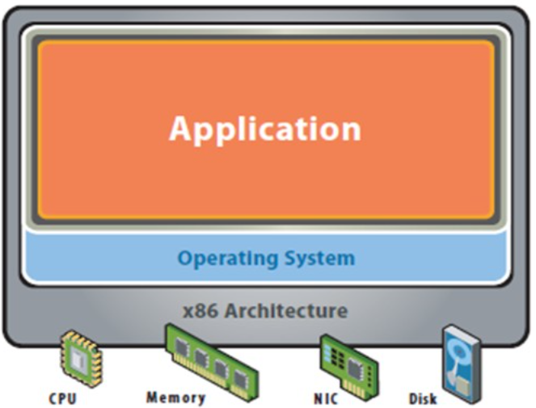
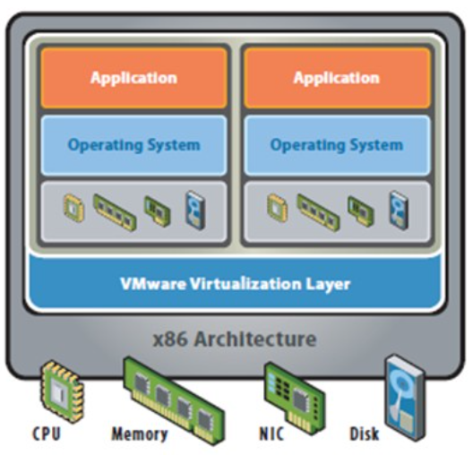
Traditional Vs. Virtual Server Model
Traditional Server Model
Virtual Server Model

Slide 7
Why Virtualization?
Most servers only use 5-15% of their capabilities on average, while consuming 60-90% of their peak power.
Solution Virtualization
Use one server to host multiple applications.
Reduce energy consumption
Reduce CO2 emissions
Generally
Operating fewer servers that are highly utilized creates additional space and reduces power consumption
Using less space and power is more environmentally friendly and reduces costs.

Slide 8
Benefits of Virtualization
More flexible and efficient allocation of resources.
Enhance development productivity.
It lowers the cost of IT infrastructure.
Remote access and rapid scalability.
High availability and disaster recovery.
Pay peruse of the IT infrastructure on demand.
Enables running multiple operating systems.
Increase Up Time
Reduce CO2 Emissions, Power and Cooling Requirements

Slide 9
Types of Virtualization
Hardware Virtualization
Operating system Virtualization
Application Virtualization
Network Virtualization
Desktop Virtualization
Storage Virtualization
Server Virtualization
Data Virtualization

Slide 10
Hardware Virtualization
Occurs when virtual machine software or virtual machine manager (VMM) is directly installed on the hardware
The main responsibility of hypervisor is to control and monitoring the processor, memory and other hardware resources.
We can install different OS on VMM and run different applications on those OS
Mainly done for the server platforms, because controlling virtual machines is much easier than controlling a physical server.

Slide 11
Operating System Virtualization
Occurs when the virtual machine software or virtual machine manager (VMM) is installed on the Host operating system instead of directly on the hardware system
This is mainly used for testing the applications on different platforms of OS.

Slide 12
Application Virtualization
Allows users to access and use an application from a remote server than the one on which the application is installed.
Admins can set up remote applications on a server and deliver the apps to an end user’s computer.
The server stores all personal information and other characteristics of the application
For the user, the experience of the virtualized app is the same as using the installed app on a physical machine.

Slide 13
Network Virtualization
It is a process of logically grouping physical networks and making them operate as single or multiple independent networks
The ability to run multiple virtual networks with each has a separate control and data plan
It co-exists together on top of one physical network. It can be managed by individual parties that potentially confidential to each other.
It provides logical switches, routers, firewalls, load balancer, VPN, and workload security within days or even in weeks.

Slide 14
Desktop Virtualization
It is technology that lets users simulate a workstation load to access a desktop from a connected device.
It separates the desktop environment and its applications from the physical client device used to access it.
It allows the users’ OS to be remotely stored on a server in the data center.
Main benefits User mobility, Portability, Easy management of software installation, updates, and patches.

Slide 15
Storage Virtualization
The process of combining physical storage from several storage devices into that appears to be a single storage device is known as storage virtualization.
It consists of a collection of servers that are managed by a virtual storage system.
Like worker bees in a hive, the servers operate without knowing the precise location of their data

Slide 16
Server Virtualization
Server virtualization is the process of dividing a physical server into multiple unique and isolated virtual servers by means of a software application.
Each virtual server can run its own OS independently
Each sub-server knows the identity of the central server
Increase performance and reduces the operating cost by the deployment of main server resources into a sub-server resource.
Advantages: Virtual migration, Reduce energy consumption , Reduce infrastructural cost etc.

Slide 17
Data Virtualization
Data virtualization is a technology that allows users to access and manipulate data from various sources as if it were in a single location without knowing more about the technical information like how data is collected, stored & formatted.
Several Big companies such as Oracle, IBM, and CData, offer their services. These can be utilized for a variety of tasks, such as:
Data integration
Business integration
Service-oriented architecture data services
Searching organizational data

Slide 18
Implementations Levels Virtualization
The are Five Levels of Implementing Virtualization
1. Instruction Set Architecture Level (ISA)
2. Hardware Abstraction Level (HAL)
3. Operating System Level
4. Library Level
5. Application Level

Slide 19

Instruction Set Architecture Level (ISA)
ISA virtualizaticanon work through ISA emulation.
Used to run many legacy codes written for a different HW configuration.
These codes run on any virtual machine using the ISA.
With this , binary code that originally needed some additional layers to run, now capable of running on the x86 machines.
It can also be modified to run on the x64 machine. For the basic emulation, an interpreter is needed, which interprets the source code and then converts it into a hardware format that can be read.
Examples: QEMU/Dynamo

Slide 20
Hardware Abstraction Level (HAL)
HAL enables virtualization to operate at the hardware level.
VM manages the HW using the virtualization process.
Virtualization HW components such as I/O device, the memory, the processor, etc.
Utilization rate is improved by having multiple concurrent users.
This is mostly used in the cloud based infrastructure.
Example: Xen/VMware

Slide 21
OS Level Virtualization
Create an abstraction layer between traditional OS and user applications.
Also known as Containers.
An isolated containers are created on single physical server
The containers function like actual servers
Examples: Jail, Virtual environment

Slide 22
Library Level Virtualization
It is the final stage of virtualization deployment in cloud computing, utilized when intended to virtualize a single application.
Also known as process level virtualization; since application typically run as a process.
Examples JVM/ .NET CLR

Slide 23
Application Level Virtualization
Applications utilize the user-level APIs from the libraries when the operating system is unmanageable.
Since API interfaces are good candidates for virtualization.
API hooks are used to control the communication between application and the rest of the system.
Examples WINE / vCUDA
What is API?
API stands for Application Programming Interface.
Interface can be thought of as a contract of service between two applications.
This contract defines how the two communicate with each other using requests and responses.

Slide 24
Virtualization Structures /Tools and Mechanism
In general, there are three typical classes of VM architecture.
Figure on the next slide shows the architectures of a machine before and after virtualization.
Before virtualization, the operating system manages the hardware.
After virtualization, a virtualization layer is inserted between the hardware and the operating system.
The virtualization layer is responsible for converting portions of the real hardware into virtual hardware.

Slide 25
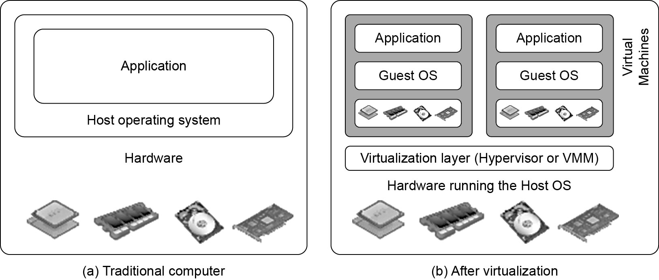
Virtualization Structures /Tools and Mechanism

Slide 26
Virtualization Structures /Tools and Mechanism
OS such as Linux and Windows can run on the same physical machine, simultaneously.
Depending on the position of the virtualization layer, there are several classes of VM architectures, namely the hypervisor architecture, para-virtualization, and host-based virtualization.
The hypervisor is also known as the VMM (Virtual Machine Monitor).

Slide 27
Hypervisor
A hypervisor is a process that creates and runs VMs
A hypervisor is a hardware virtualization technique allowing multiple OS, to run on a host machine.
Hardware-level virtualization on bare metal devices like CPU, memory, disk and network interfaces.
The hypervisor software sits directly between the physical hardware and its OS.
The hypervisor provides hypercalls for the guest OSes and applications.
Generally there are two types of hypervisors
Type 1 hypervisor and Type 2 hypervisor

Slide 28
Hypervisor
Type 1
It is also known as a Native or Bare metal hypervisor
Runs directly on the host’s hardware
It does not require any base server operating system
It has direct access to hardware resources.
Type 2
Also called Hosted Hypervisor
Run over a host operating system
It is the second layer over the hardware
Guest OS run a layer over the hypervisor.
The OS is usually unaware of the virtualization

Slide 29
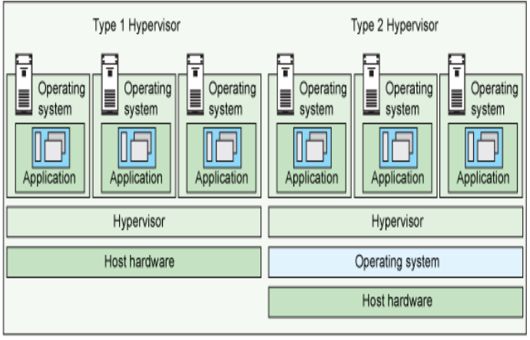

Slide 30
Binary Translation with Full Virtualization
Depending on implementation technologies, hardware virtualization can be classified into two categories:
Full virtualization
Host-based virtualization.
Full virtualization
It does not need to modify the host OS.
It relies on binary translation to trap and to virtualize the execution of certain sensitive, non virtualizable instructions.
The guest OSes and their applications consist of noncritical and critical instructions.

Slide 31
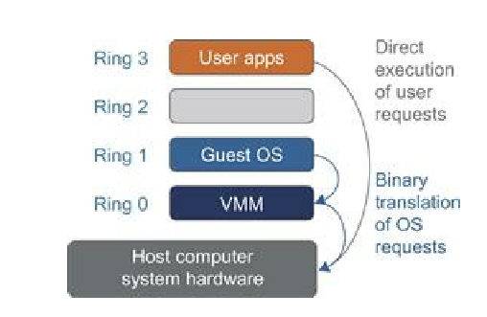
Binary Translation of Guest OS Requests Using a VMM

Slide 32
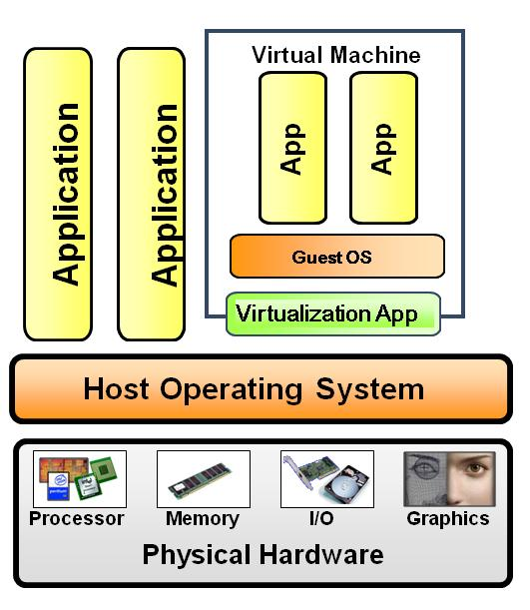
Install a virtualization layer on top of the host OS.
Advantages.
The user can install VM without modifying the host OS.
Flexible
Disadvantages
Performance is low to be useful in practice. When an application requests hardware access, it involves four layers of mapping
Host-based virtualization

Slide 33
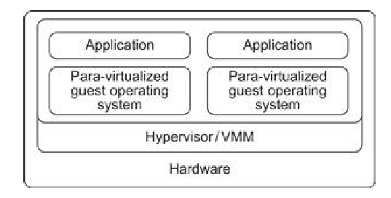
Para-virtualization
It needs to modify the guest OS
VM provides special APIs to OS modifications in user applications.
Performance degradation is a critical issue

Slide 34
CPU, Memory, and I/O Virtualization
To support virtualization, processors such as the x86 utilize a special running mode and instructions, known as hardware-assisted virtualization.
In this way:
The VMM and guest OS run in different modes and,
All sensitive instructions of the guest OS and its applications are trapped in the VMM.
To save processor states, mode switching is completed by hardware.
For x86 architecture, Intel and AMD have proprietary technologies for hardware-assisted virtualization.

Slide 35
CPU Virtualization
A VM is a duplicate of an existing computer system in which a majority of the VM instructions are executed on the host processor in native mode.
Thus, unprivileged instructions of VMs run directly on the host machine for higher efficiency.
Other critical instructions should be handled carefully for correctness and stability.
Critical instructions are divided into three categories:
privileged instructions,
control–sensitive instructions, and
behavior-sensitive instructions.

Slide 36
CPU Virtualization
Privileged instructions execute in a privileged mode and will be trapped if executed outside this mode.
Control-sensitive instructions attempt to change the configuration of resources used.
Behavior-sensitive instructions have different behaviors depending on the configuration of resources, including the load and store operations over the virtual memory.

Slide 37
CPU Virtualization
A CPU architecture is virtualizable if it supports
The ability to run the VM’s privileged and,
Unprivileged instructions in the CPU’s user mode while the VMM runs in supervisor mode.
When the privileged instructions including control and behavior-sensitive instructions of a VM are executed, they are trapped in the VMM.
In this case, the VMM acts as a unified mediator for hardware access from different VMs to guarantee the correctness and stability of the whole system.

Slide 38
CPU Virtualization
However, not all CPU architectures are virtualizable.
RISC CPU architectures can be naturally virtualized because all control and behavior-sensitive instructions are privileged instructions.
On the contrary, x86 CPU architectures are not primarily designed to support virtualization.

Slide 39
Memory Virtualization
Virtual memory virtualization is similar to the virtual memory provided by modern OS.
In a traditional execution environment, the OS maintains mappings of virtual memory to machine memory using page tables, which is a one-stage mapping from virtual memory to machine memory.
All modern x86 CPUs include MMU and a TLB to optimize virtual memory performance.

Slide 40
Memory Virtualization
However, in a virtual execution environment, virtual memory virtualization involves sharing the physical memory in RAM and dynamically allocating it to the physical memory of the VMs.
That means a two-stage mapping process should be maintained by the guest OS and the VMM, respectively: virtual memory to physical memory and physical memory to machine memory.

Slide 41
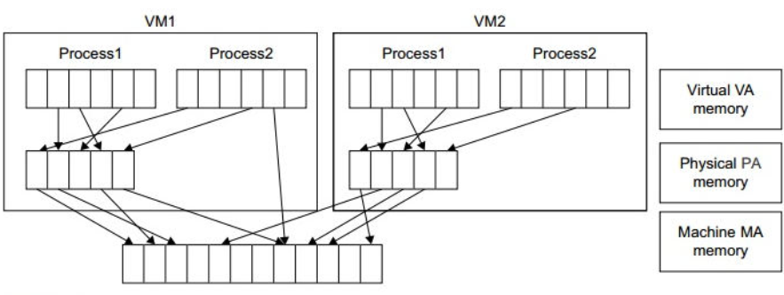
Memory Virtualization

Slide 42
I/O Virtualization
I/O virtualization involves managing the routing of I/O requests between virtual
devices and the shared physical hardware.
There are three ways to implement I/O virtualization: full device emulation, para-virtualization, and direct I/O.
I/O virtualization. Generally, this approach emulates well-known, real-world devices.
All the functions of a device or bus infrastructure, such as device enumeration, identification, interrupts, and DMA, are replicated in software. This software is located in the VMM and acts as a virtual device.

Slide 43
I/O Virtualization
The para-virtualization method of I/O virtualization is typically used in Xen.
It is also known as the split driver model consisting of a frontend driver and a backend driver.
It achieves beer device performance than full device emulation, it comes with a higher CPU overhead
Direct I/O virtualization lets the VM access devices directly.
It can achieve close-to native performance without high CPU costs.

Slide 44
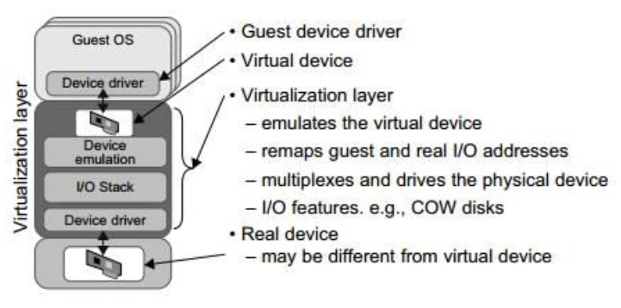
I/O Virtualization
The full device emulation approach

Slide 45
Thank you!

